Slide 1

CS 719 Data Science Project (Fall 2024)
AzureSentiment: Sentiment Analysis Using Azure and Bing News API
Name: Joshi Jay Vijaybhai
Student Id: 200485155

Slide 2
TABLE OF CONTENTS
01
02
03
04
05
06
Goals and Motivation
Method of the project
Project Architecture
Achievements
Challenges and Solutions
Result
07
08
Suggestions for
Future Research
Conclusion

Slide 3
Goals and Motivation
01

Slide 4
Goals:
- Develop a real-time news analytics application for sentiment analysis.
- Use advanced data engineering and machine learning techniques.
- Use Microsoft's Bing News Search API, Azure services, and Power BI.
- Gives insights and Support strategic decision-making, crisis management.
Motivation:
- Understand patterns in media sentiment, which can indirectly influence public opinion and discourse.
- Provide a dynamic, data-driven approach to track sentiment shifts.
- Enable timely and informed responses to emerging trends and events.

Slide 5
Method of the project
02

Slide 6
Tools:
Microsoft Fabric
Azure Data Lake
Synapse
Bing API
Power BI
Teams
01
02
03
04
05
Data
Ingestion
Data
Transformation
Sentiment
Analysis
Data
Visualization
Real-Time
Alerts

Slide 7
Project Architecture
03

Slide 8
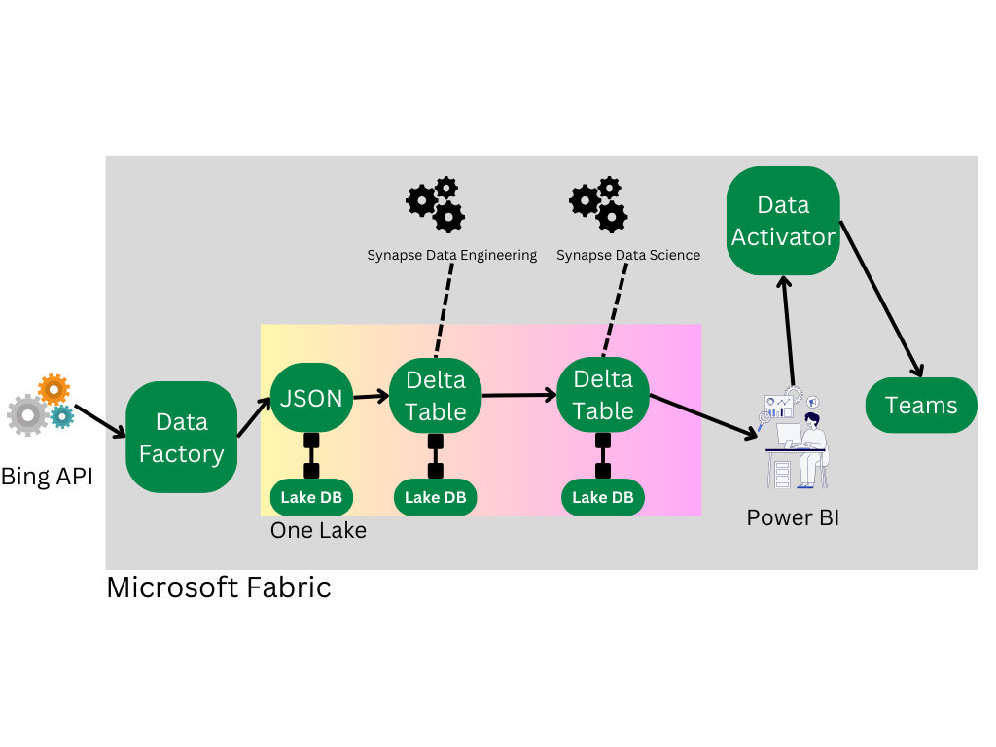
Dotted Line: Represents tools utilized for operations (e.g., Synapse, Power BI).
Double-Square Line: Indicates storage points for processed data (e.g., OneLake).

Slide 9
Achievements
04

Slide 10
Main Achievements
Scalable and Efficient Data Pipeline
Automated Alerts for Proactive Monitoring
Parameterized and Flexible Data Ingestion
Seamless Real-Time Data Integration
2
4
1
3

Slide 11
Challenges and Solutions
05

Slide 12
Inconsistent API Response Structure:
Problem: The responses from Bing's API often fail to include the key attributes like 'categories' and 'image,' thereby causing errors while processing JSON results.
Solution: Implementation of conditional checks excluding articles that do not possess these critical properties since the latter are related to properties of extreme importance to our dashboard and analysis.
Analysis Exception in Table
Problem: 'Analysis Exception' used to pop up every time i tried to merge the data with existing tables in each run.
Solution:Used try-except handling with incremental load logic to avoid errors with tables that already exist.
Used the AnalysisException library for consistent merging of data.

Slide 13
Result
06

Slide 14
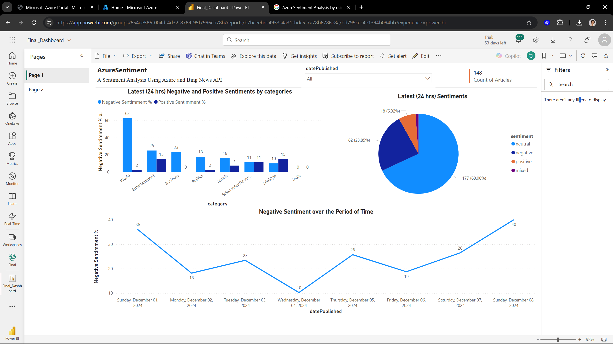
Dashboard Page:-1

Slide 15
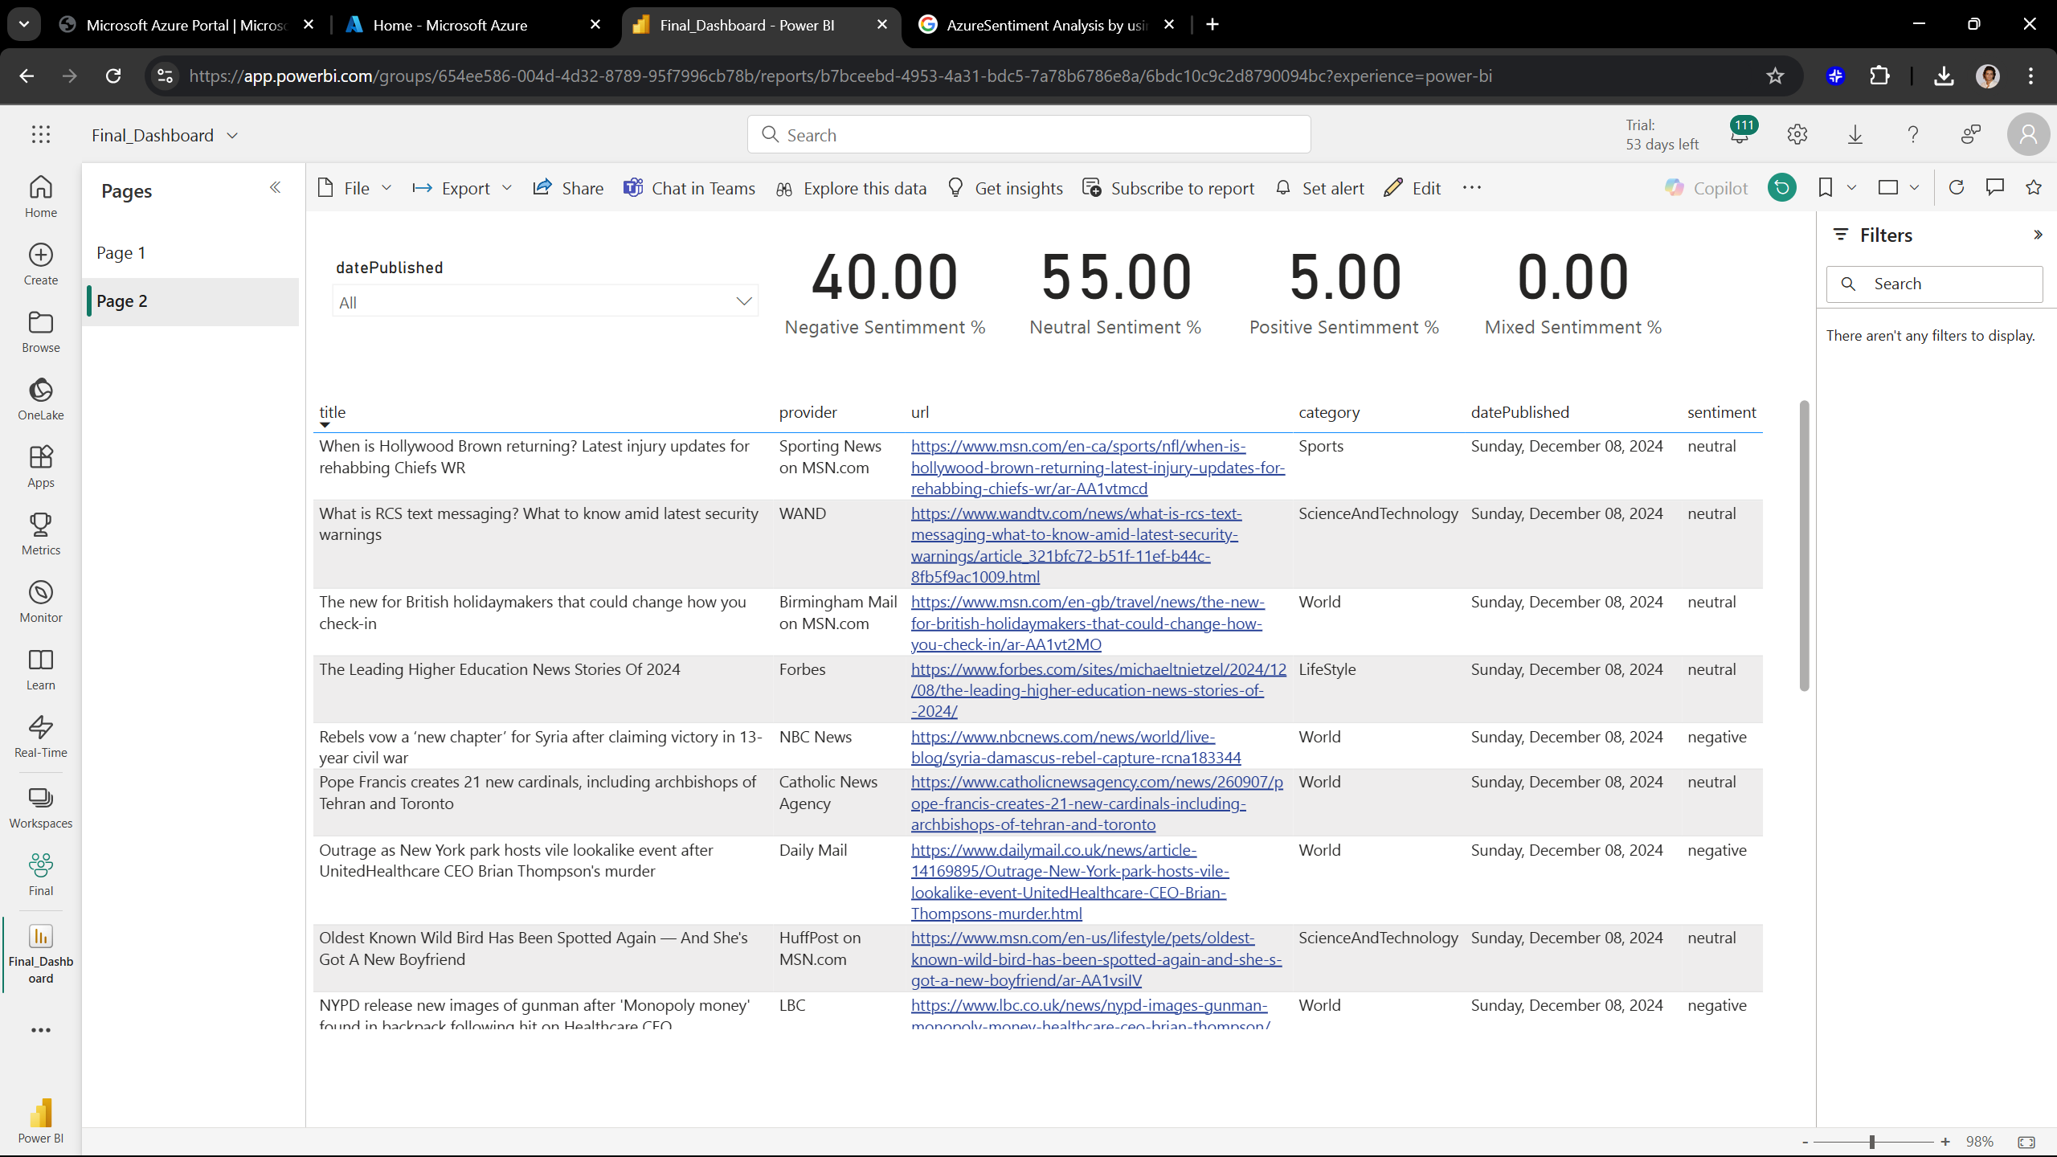
Dashboard Page:-2

Slide 16
https://app.powerbi.com/links/fP2XVawMhg?ctid=9955b91e-0906-45c8-831a-08c34a06d1ae&pbi_source=linkShare
Dashboard link
Note:- You will require to enter my azure credentials which i provided along with source code in UR Courses source code submition to access this link.

Slide 17
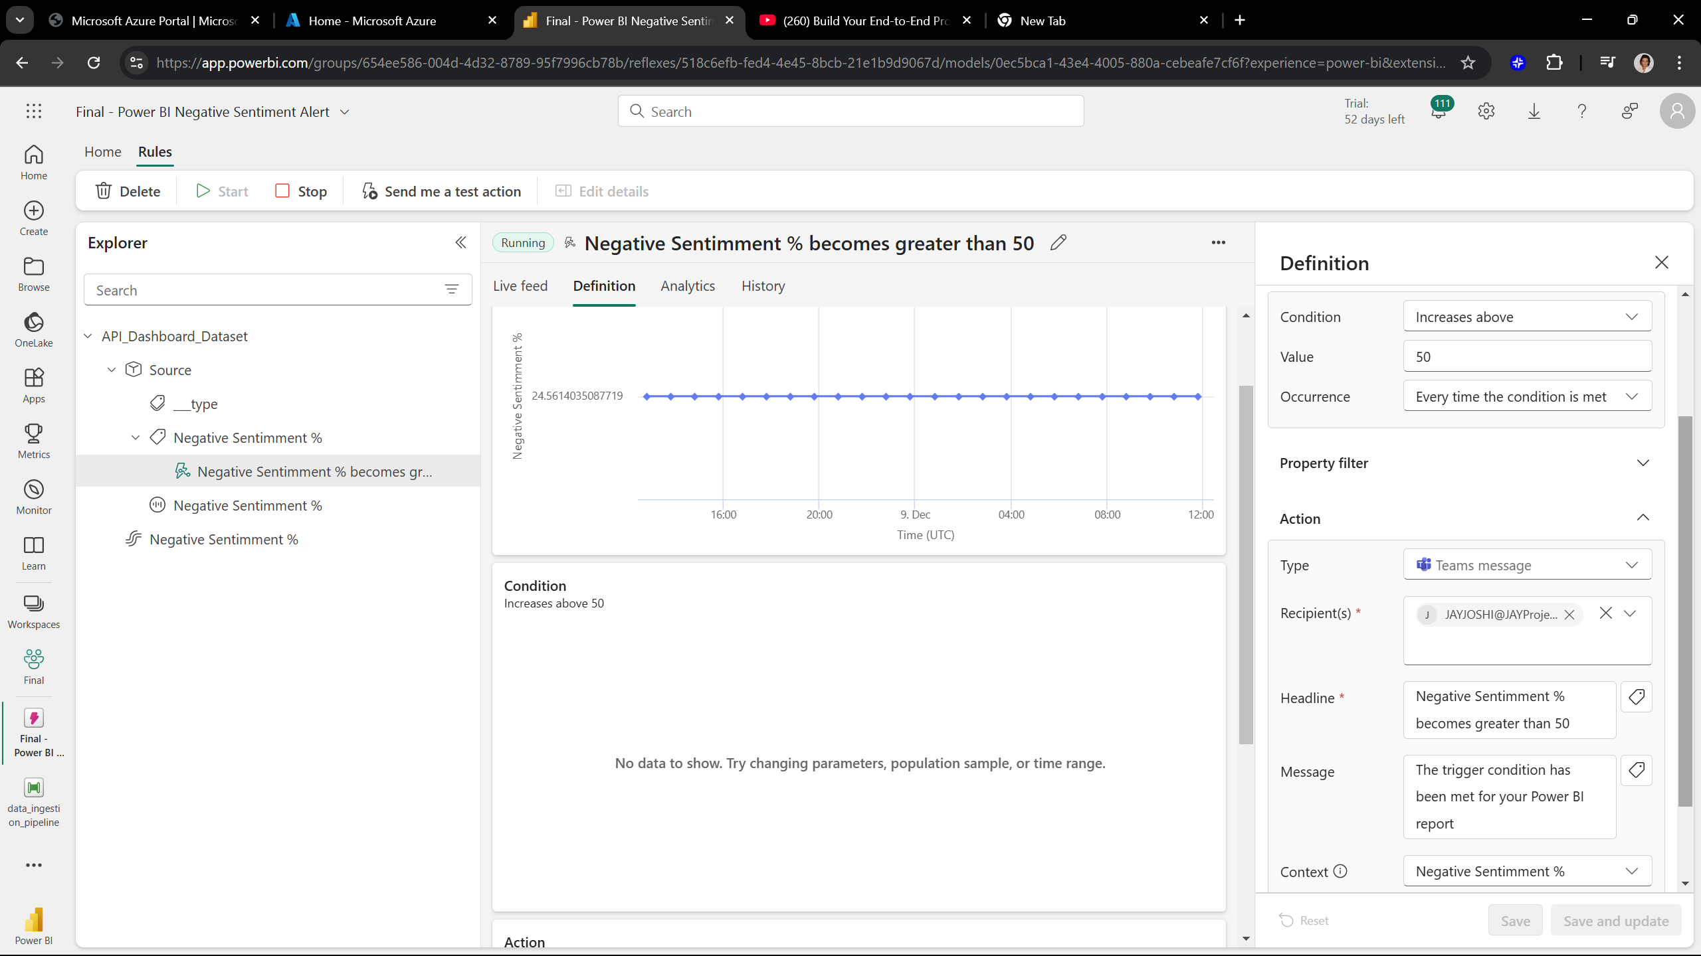
Data activator monitoring

Slide 18
https://app.powerbi.com/groups/654ee586-004d-4d32-8789-95f7996cb78b/reflexes/518c6efb-fed4-4e45-8bcb-21e1b9d9067d/models/0ec5bca1-43e4-4005-880a-cebeafe7cf6f?experience=power-bi&extensionScenario=openArtifact
Data activator monitoring link
Note:- You will require to enter my azure credentials which i provided along with source code in UR Courses source code submition to access this link.

Slide 19
Suggestions for Future Research
07

Slide 20
Current Limitations
limited accessibility for non-technical users.
Absence of a user-friendly keyword management interface.
Proposed Enhancements
Integrate keyword management into the dashboard for a user-friendly experience.
Enable non-technical users to manage keywords independently.

Slide 21
Conclusion
08

Slide 22
Conclusion
Scalable, automated data ingestion and processing using Azure Data Lake and Azure Data Factory.
Empowered businesses and organizations with actionable insights to manage public sentiment effectively.
Scalable & Adaptive: A robust solution for handling growing data volumes and adapting to changing trends.
Multidimensional Solution: Integrating data engineering, machine learning, and data visualization to address real-world challenges.

Slide 23
Thank You!

